Slide 1
Digital Portfolio
STUDENT NAME:VENKATESH P
REGISTER NO : 2422k1244
DEPARTMENT: B.SC COMPUTER SCIENCE
COLLEGE: GOVERNMENT COLLEGE OF ARTS SCIENCE THITAMAlAI
UNIVERSITY: BHARATHIAR UNIVERSITY

Slide 2
PROJECT TITLE
SUSTAINABILITY & GREEN INITIATIVES

Slide 3


AGENDA
Problem Statement
Project Overview
End Users
Tools and Technologies
Portfolio design and Layout
Features and Functionality
Results and Screenshots
Conclusion
Github Link
3/21/2024 Annual Review

Slide 4

PROBLEM STATEMENT
Climate change is accelerating due to high greenhouse gas emissions.
Over-dependence on fossil fuels leads to pollution and resource depletion.
Improper waste management increases landfills and ocean pollution.
Urbanization and deforestation reduce biodiversity.
Lack of awareness about sustainable alternatives like solar, recycling, and water-saving methods.
Urgent need for digital awareness platforms to educate and motivate peop
Rapid increase in plastic pollution and waste mismanagement.
Deforestation leading to biodiversity loss.
Freshwater scarcity due to overuse and pollution.
Lack of awareness and adoption of sustainable practices among communities.

Slide 5

PROJECT OVERVIEW
This project focuses on creating a digital portfolio to showcase green initiatives and sustainability efforts.
Acts as a knowledge hub for eco-friendly practices.
Demonstrates technology-driven solutions such as energy dashboards, waste trackers, and awareness campaigns.
Encourages community participation through interactive design and case studies.
Highlights the role of students, NGOs, and corporates in achieving global sustainability goals (SDGs).
Focus areas: Renewable energy adoption (solar, wind, hydro) Waste segregation & recycling systems Water conservation methods Biodiversity & afforestation campaigns
Combines technology and environmental responsibility to spread awareness.
Provides an interactive platform showcasing sustainability initiatives.

Slide 6

WHO ARE THE END USERS?
Students & Educators – integrate sustainability into learning.
Communities – adopt eco-friendly practices in daily life.
Government & NGOs – to spread awareness through digital campaigns.
Corporate Companies – to showcase CSR (Corporate Social Responsibility) initiatives.
General Public – to gain practical tips for green living.
Researchers & Innovators – develop green technologies, renewable energy solutions, and eco-friendly materials.
Farmers & Agricultural Sector – adopt organic farming, sustainable irrigation, and waste-free practices
Healthcare Professionals – promote eco-health practices, reduce hospital waste, and encourage green infrastructure in healthcare.
Media & Influencers – create engaging sustainability content, documentaries, and viral campaigns.
Energy Providers – shift to renewable sources like solar, wind, and hydropower.

Slide 7

TOOLS AND TECHNIQUES
Web Development: HTML, CSS, JavaScript
Design & Prototyping: Canva, Figma, Adobe XD
Data Visualization: Chart.js, Recharts
Hosting & Version Control: GitHub Pages
Team Collaboration: Trello, Google Workspace
Awareness Media: Infographics, Videos, Animations
Communication Tools: Google Workspace, Trello (team collaboration)

Slide 8
POTFOLIO DESIGN AND LAYOUT
Theme: Minimalistic & eco-friendly with green/blue palettes.
Navigation: Smooth, with dedicated sections (Problem → Solution → Results).
Responsive Design: Works on desktop, tablet, and mobile.
Visual Appeal: Use of icons, infographics, and animations.
Sections Included:
1.About Project
2.Green Initiatives (Energy, Waste, Water, Biodiversity)
3.Features & Tools
4.Results Dashboard
5.Community Section
6.Future Scope
8

Slide 9
FEATURES AND FUNCTIONALITY
Awareness Hub – Blogs, facts, and tips for sustainability.
Waste Recycling Tracker – User-friendly system to monitor recycling habits.
Water-Saving Monitor – Tracks household/office water usage.
Energy Dashboard – Graphs showing renewable energy usage.
Community Sharing Platform – Users can share eco-friendly practices.
Impact Calculator – Shows CO₂ savings, energy reduction, or waste minimized
Interactive UI – User-friendly, engaging experience with real-time data visualization.

Slide 10
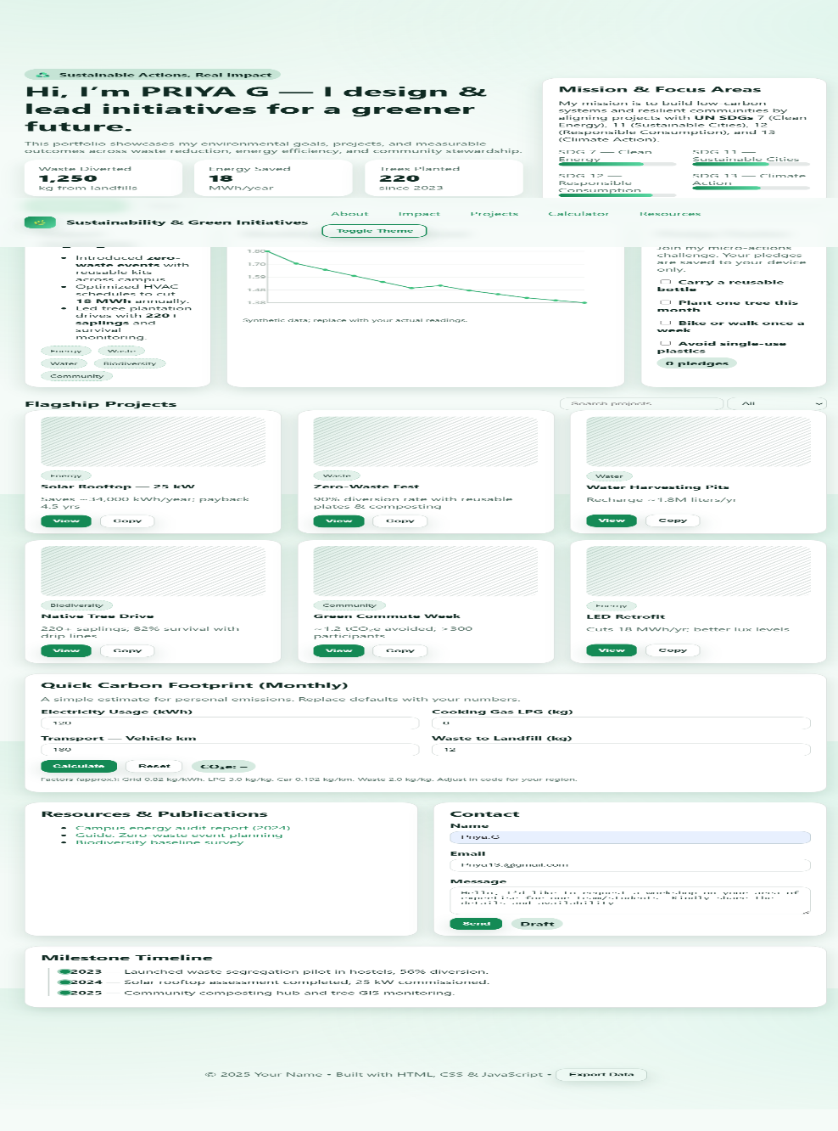

RESULTS AND SCREENSHOTS
RESULTS:
Positive Impact Metrics:
Awareness levels improved among target users.
Simulation shows reduction in waste and energy usage.
Increased participation from community groups.
3/21/2024 Annual Review
10

Slide 11
CONCLUSION
.
The Sustainability & Green Initiatives Project successfully combines technology + environmental awareness.
Helps communities adopt eco-friendly lifestyles through digital engagement.
Encourages youth participation in environmental conservation.
Contributes to achieving UN Sustainable Development Goals (SDG 7 – Affordable & Clean Energy, SDG 12 – Responsible Consumption, SDG 13 – Climate Action).
Future scope:
Integration with IoT devices for real-time tracking.
Expansion into mobile app platforms.
Collaboration with NGOs & educational institutions for wider impact.
AI-driven predictive analysis for environmental impact.
Partnership with green startups for practical implementation.
11

